Slide 1
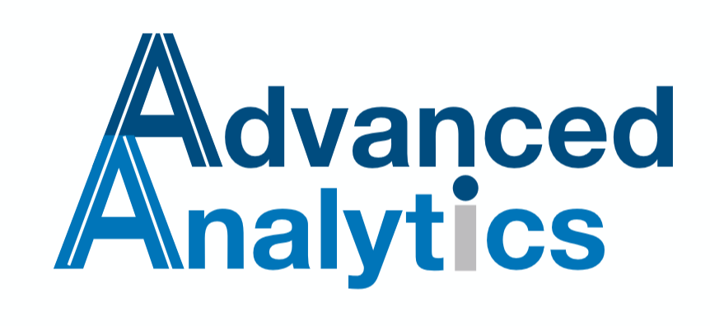

C3.AI Suite First Analysis
Comparison (when possible) with Palantir/Foundry
Version 0.2
Juillet 27, 2020
Confidential – Internal Use Only

Slide 2
Summary
Context
Platform overview
Data Integration
Data Analysis
Machine Learning
Stream Processing
Summary

Slide 3
1 - Context
The purpose of this document is to give a feedback on our brief experience of C3 AI Suite utilisation. We will only talk about what we have seen so far during our first training (C3 AI Fundamentals).
Whenever it’s possible, we highlight the differences we have noticed between the C3.AI Suite and Palantir Foundry platform.
Please keep in mind that our vision of Palantir Foundry is limited to our experience on Foundry Skywise which is a Palantir Foundry customised platform.

Slide 4
2 - Platform overview: Introduction to C3 AI Suite
The C3 AI Suite™ is software that uses a model-driven architecture to accelerate delivery and reduce the complexities of developing enterprise-scale AI applications. The C3 AI Suite enables organizations to deliver AI-enabled applications faster than alternative methods while reducing the technical debt from maintaining and upgrading these applications.
Features
Low-Code/No-Code Simplify the design, development, deployment, and operation of enterprise-scale AI applications.
Machine Learning Services Manage the full life cycle of machine learning from experimentation to production.
Self-Service Analytics and ML Enable all users to collaborate on machine learning algorithms with C3 Ex Machina.
Time Series Natively treat all data as time series for rapid analytics development.
Continuous Analytics Ensure mission-critical analytics are always up to date.

Slide 5
2 - Platform overview: Introduction to C3 AI Suite
Data Exploration Simplify and unify access to enterprise data.
Virtual Data Lake Seamlessly integrate with operational stores and data warehouses.
Integration Services Rapidly integrate with any system with data integration pipelines.
Connectors Leverage over 200 prebuilt connectors to rapidly ingest, transform, or map a broad set of external data sources into C3 Models.
Multi-Cloud Services Deploy to private or public cloud instances on Azure, AWS, and Google Cloud Platform.
Platform Services A comprehensive suite of platform services to speed, scale, and secure the C3 AI Suite.
Governance and Security A world-class security and operations infrastructure.

Slide 6
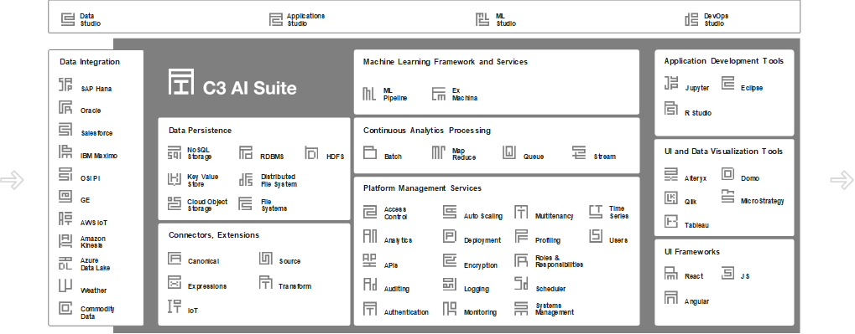
2 - Platform overview: C3 AI Platform overview

Slide 7
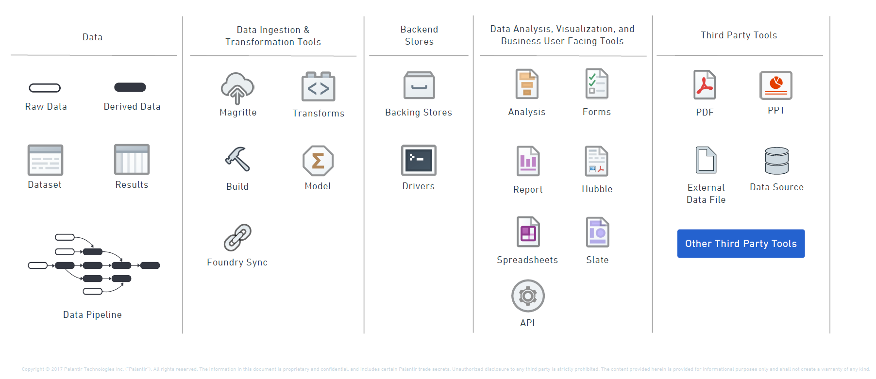
2 - Platform overview: Palantir Foundry icons

Slide 8
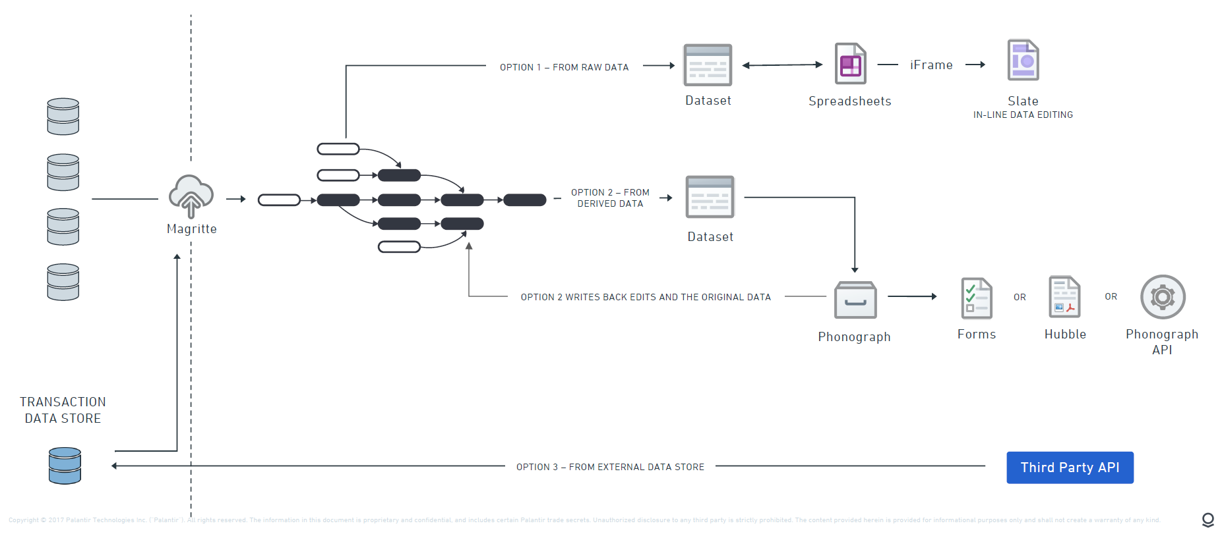
2 - Platform overview: Foundry Architecture Diagram (A customised example)

Slide 9
2 - Platform overview: Comparison with Palantir Foundry (Skywise) :
The architecture used in Foundry is critical to harness the power of Foundry into a seamless, integrated data system. Architecture diagrams help communicate the design, deployment and topology.
Here you will find an official collection of Palantir icons that will serve as a starting point for building your own Foundry architecture. Users should expect to combine, mold, and customize patterns when building out the actual architecture.
Palantir experts works closely with a customer to meet an organization’s specific needs.

Slide 10
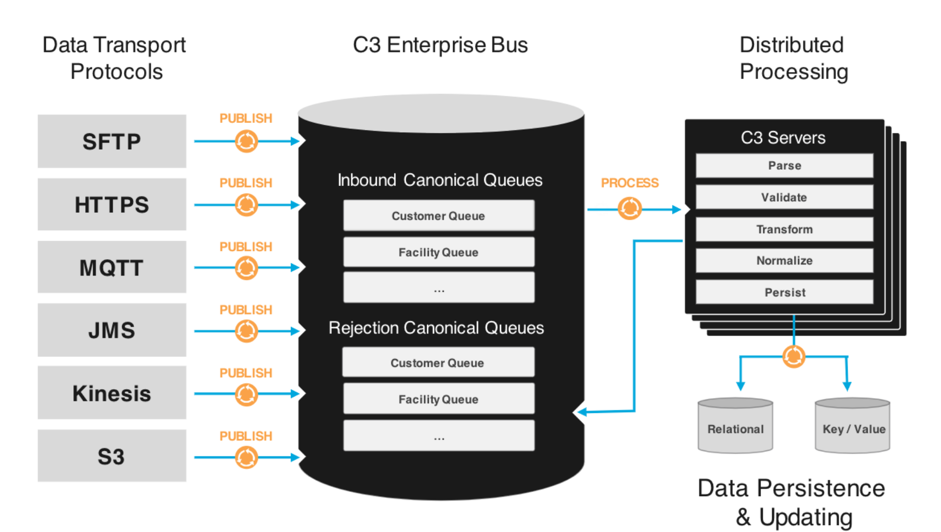
3 - Data Integration
The C3 AI Suite enables rapid integration of data from enterprise, extraprise, and sensor data feeds with support for both structured and unstructured data.
The C3 AI Suite is able to ingest data in batch, stream, or message-based integrations. It also has prebuilt connectors to many common data sources, including Postgres, Oracle, SAP, HBase, HDFS, Apache Kafka, AWS Kinesis, Impala, Snowflake, and Cassandra.
Data integration services are extensible, enabling developers to configure and enable additional connectors.

Slide 11
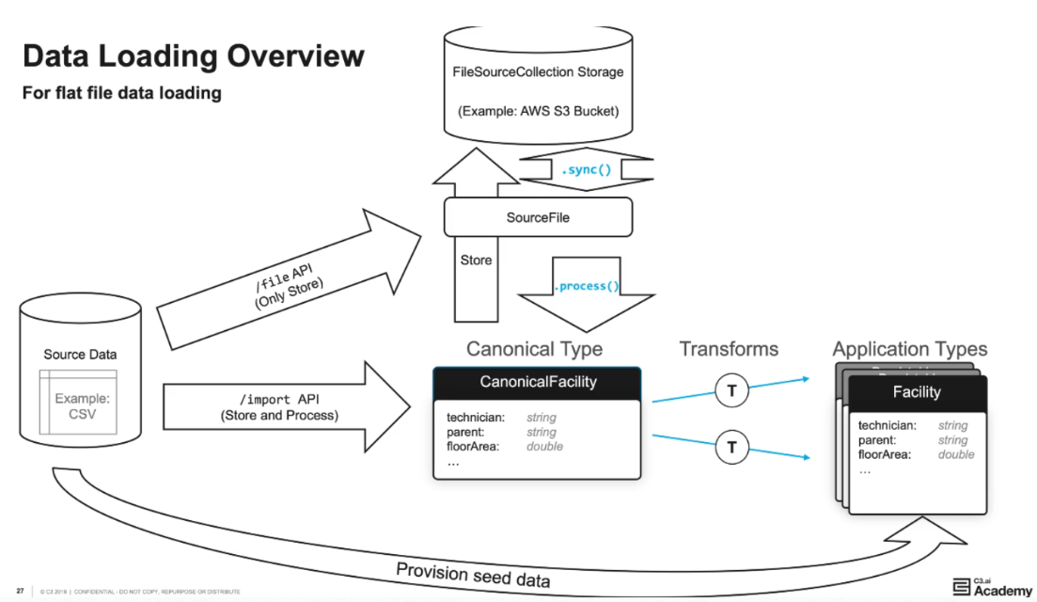
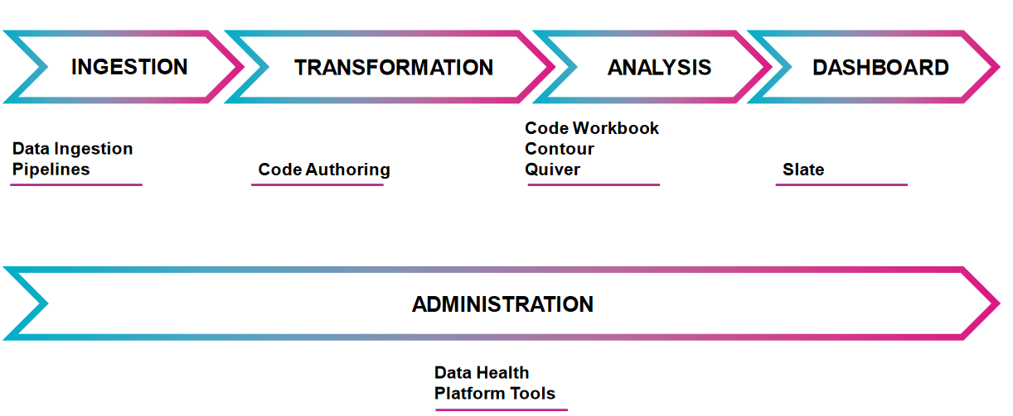
3 - Data Integration : Comparison with Palantir Foundry
Foundry
C3.AI Suite

Slide 12
3 - Data Integration: Comparison with Palantir Foundry
We notice that for both Palantir Foundry and C3 AI Suite, they provide the capability to ingest data from different sources fitting in an unified data model. But there are still some differences in their data integration mechanism.
In Foundry, raw data need to be loaded firstly onto platform and it doesn’t provides any access to external data set for any directly usage like transformation on platform. After loading raw data onto platform, the related transforamtion on raw data can be processed. The loading raw data will not be influenced by the absence of data model or data transformation step. So for Foundry, the data integration can be divided into Extract/Load, Transform.
But in C3 AI Suite, the data integration need to be passed by Canonicals and the Canonical type is the first step in bringing data from outside the environment to the inside. Without the definition of Canonical type or even Canonical transformation type, the data loading cannot be succed. Meanwhile, C3 AI Suite provide access to external lakes or repositories. Then the steps of data integration are: Extract, Transform, Load.
We will present the differences in separated steps.

Slide 13
3.1 - Data Ingestion : Comparison with Palantir Foundry
For Foundry, as the raw data need to be loaded onto platform firstly before any usage, the extraction of raw data and the loading are both processed in first step. The data ingestion on Foundry can be done either by manual uploading or Magritte Agent Sync. Then raw data will appear in its original way on platform. There’s the size and data source restriction for manual uploading and the data schema can also be predefined or modified when you upload it. For Magritte Agent Sync, you can customize the agent to sync whatever data source you want and use SQL command to select the attributes you want. The sync frequency can also be defined.
Foundry also provides different ingestion mode: snapshot, append, update, delete.
But in C3 AI Suite, the data integration need to be passed by Canonicals. Canonical types(schemas), describes existing integration endpoints, the format that they accept and the relationships between canonical entities. That’s the first step in bringing data from outside the environment to the inside.
Therefore the data integration seems to be more simple in Palantir Foundry, raw data can be uploaded directly and appear on Froundry in its original way. Oherwise C3 AI Suite requires a pre-defined Canonical type to present the structure of the data in the source system.
However, the benefits of C3 Canonicals are also obvious. They help ensure that the data coming into C3 are consistent, and provide a layer of abstraction from persisteble c3 types. The integrations are insulated from data model changes. (More details in next page)

Slide 14
3.1 - Data Ingestion : Comparison with Palantir Foundry
The benefits of C3 AI Suite are:
Using Canonicals helps prevent issues related to changes from the source system (system of record).
Canonicals help ensure that the data sent to C3 are consistent by defining what the C3 AI Suite should expect to see and validating that the inbound data meets that specification.
Additionally, canonicals help manage changes from the application side. Different applications sometimes need their own data models to support new functionality. Rather than changing the common data messaging format, developers instead write a new transform to a newly created Type. As with other C3 Types, Canonicals can also be extended and changed if needed.
Compared to Foundry, it sync or uploads the raw data directly onto platform in its original way then you have no idea about the relationships between different datasets. Without that insulation between integration therefore source system and the subsequent data model changes, more works are needed in transformations step. The CLEANED sub-step in transformation play a same role as Canonical type.

Slide 15
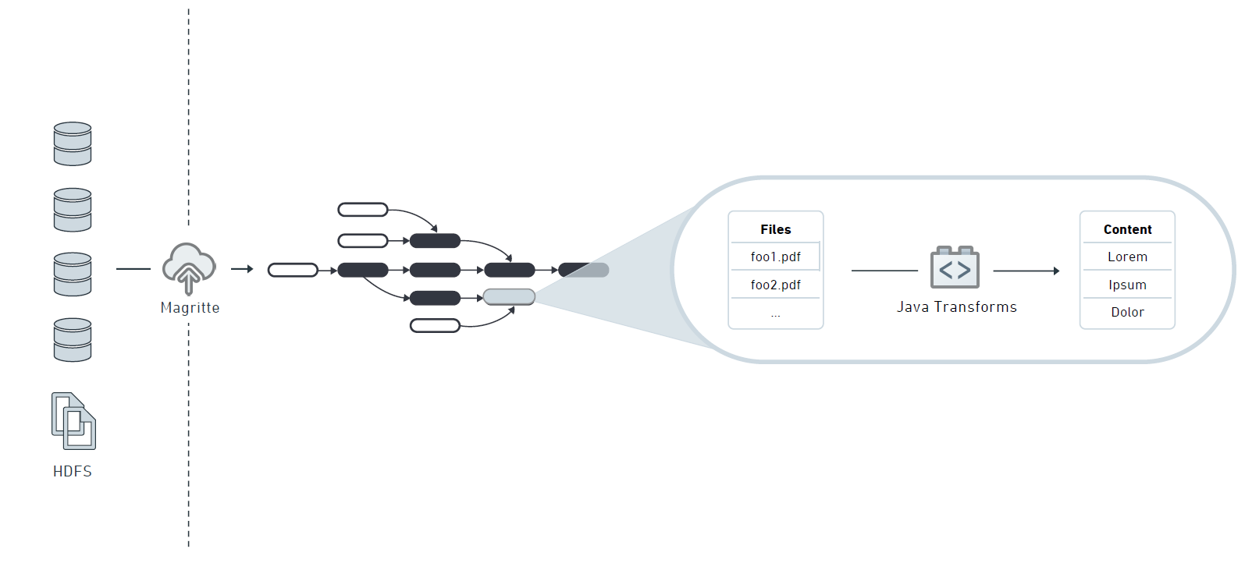
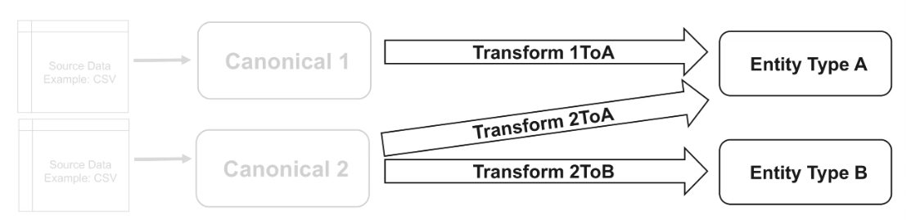
3.2 - Data Transform: Comparison with Palantir Foundry
Ontology schema applied
Foundry
Java, SparkSQL, PySpark
C3.AI Suite
JavaScript, Python, R

Slide 16
3.2 - Data Transform: Comparison with Palantir Foundry
The data transformation on C3 AI Suite is called Canonical transforms. It’s a mapping between a Canonical schema and a perceptible C3 type, which allows data to be loaded into multiple types and to implement transformation logic. Canonical transforms can use either powerful expression language(optimized, fast and simple) or JavaScript. The C3 AI Suite provides a Expression Engine Function Library for all built in expressions.
Compared to Palantir Foundry : On Foundry, the data transformation are processed by Code Authoring. The transformation can be done with SQL or python which means we can use powerful libraries of python like pandas, numpy, etc. But the most recommended way is using Pyspark functions instead of pandas or UDF for performance seeking. Obviously, both python, SQL and pyspark on Foundry are much more familiar to data scientist or data engineer.
Code Authoring also provides a git based dev environment which facility the team collaboration and version release.There’re different methodes of data transformations on Foundry like append, snapshot etc.
Except the language used and the dev environement for transformation on C3 AI Suite and Foundry, another big difference is C3 AI Suite separates the steps of raw data cleaning and real data transformtion into two types, Canonical type and Canonical Transform type. Therefore the ingestion of raw data includes also the step of cleaning. However in Foundry, all data related treatments are packaged into the transformation step.

Slide 17
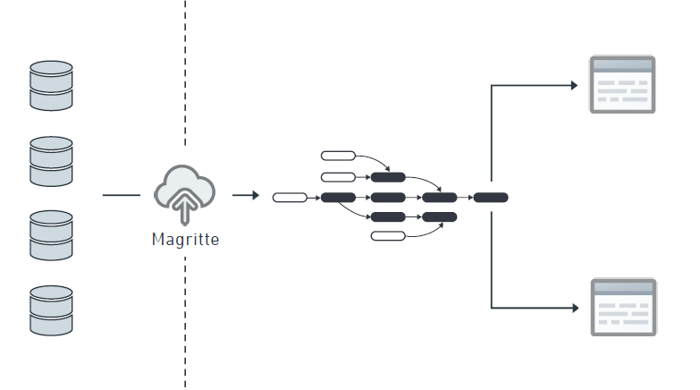
3 - Data Load : Comparison with Palantir Foundry
Foundry
C3.AI Suite

Slide 18
3.3 - Data Load: Comparison with Palantir Foundry
In C3 AI Suite, there’re three ways to load data and you need to figure the Canonical type which you want to load data in:
Through the use of the import API, the file is uploaded to the AI Suite, and the system looks for a file source collection associated with the canonical, stores the file in that location, creates a source file instance representing this file, and triggers the entire data integration pipeline starting from that canonical.
Use the file API. This will store data in the source system but it won’t be processed automatically.
To provision the source data as seed data. In this case, the data will be applied directly to the specified types.
You can also upload data by using Postman easily.
Compared to Palantir Foundry : the raw data is loaded in the first step of data integration by either Magritte agent or manual uploading. The Magritte agent can be customized.

Slide 19
4 – Data Analysis
On C3 AI Suite, the data analysis can be processed either in Console or in Jupyter Notebook. There’s no tools to facility it.
Compared to Palantir Foundry : Foundry provides powerful analysis tools to let users without programming knowledge can also perform data analysis on platform. Here the tools can be used:
Contour: a point-and-click data analysis tool that allows you to quickly access datasets, conduct common analytical and logical operations in sequence to explore, debug, cleanse and transform your data. You can also create a report to share the analysis.
Quiver: a visualization tool for time-series data
Code WorkBook: a tool to code your own data analysis process. Compared to repository, the code workbook is faster, easier, more flexible to use.
There’s also a tool, slate which allows user to build the dashboard with javascript quickly and easily.

Slide 20
5 - Machine Learning
The ML pipeline on C3 AI suite are an efficient, re-usable and composable way of combining a sequence of actions leading to trained model or prediction. It’s similar to Scikit-learn pipeline, one major difference is the support of the multiple platform integration. The main benefits of ML pipeline are:
Having defined a pipeline, we then only need to call the train or process method command once
Allows for hyperparameter selection
Reduces the chances of information leakage during cross-validation
Compared to Palantir Foundry : From our knowledge, as Foundry has integrated sklearn package onto the platform, its ML pipeline should be the Scikit-learn pipeline.

Slide 21
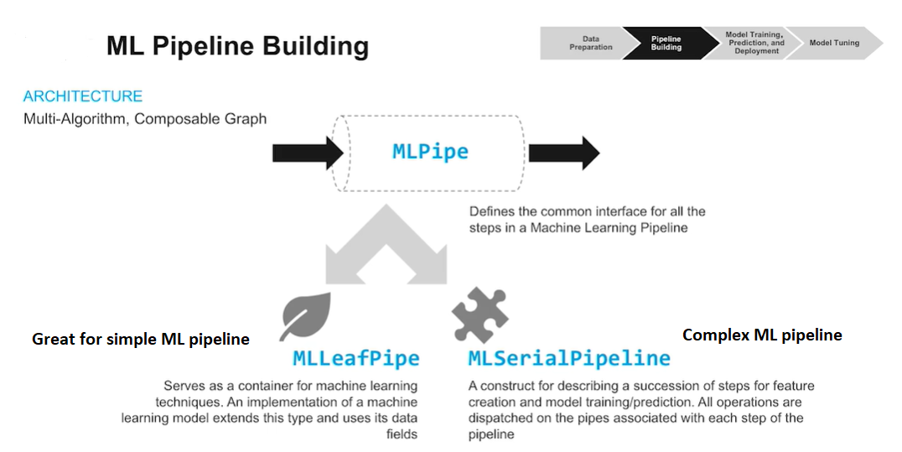
5 - Machine Learning
C3.AI Suite

Slide 22
5 - Machine Learning Development
The C3 AI suite provides the connection from Jupyter Notebook that’s familiar to data scientists. They can leverage their pre-existing knowledge of open source libraries to rapidly prototype models and evaluate them before being ready production.
After connecting to the C3 AI Suite from a Jupyter Notebook, you can leverage the power of the platform to evalutate metrices in a paralyzed fashion, which speeds up the process of feature engineering. Once these metrics or features are downloaded onto their notebook, a data scientist can begin training the model and evaluating its performance, then unpert train models into production.
As working in Jupyter Notebook, both train locally and trained on platform are supported. After local training, you can upsert your model onto platform. For training on platform, by writing python APIs and python Runtime, you can also use the off-the-shelf python solutions from libraries like Scipy, TensorFlow, Keras on C3 AI Suite. C3 AI Suite also supports NLP and Deep Learning.
Compared to Palantir Foundry : You can only develop your machine learning models in Foundry’s repository or workbook. You can only use the integrated libraries like scikit-learn and the model tunning should be done out of Foundry. Foundry doesn’t support NLP and Deep Learning.

Slide 23
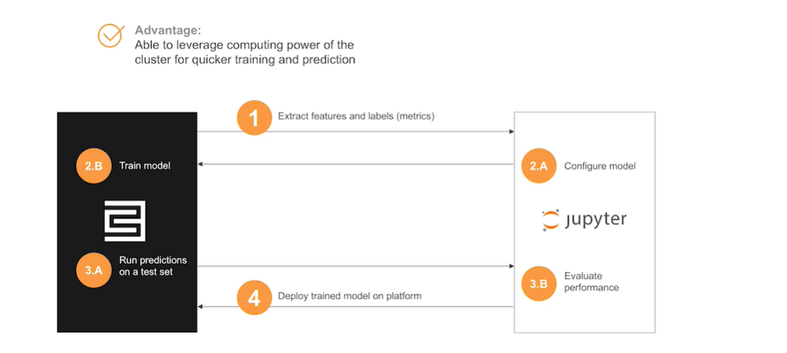
5 - Machine Learning Development
C3.AI Suite

Slide 24
6 – Stream Processing
Analytics on C3 AI Suite is the code that takes a defined input, processes that input according to the business logic defined by the code. And then performs some action or produces some other predefined output. They are powered by the Analytics Container Engine which lets you automate reponses to data changes based on the logic you provided.
In production environments, data flow through all the time. we may still need to develop and train our models with tools like Jupyter Notebooks even as new data comes in. ACE will automatically detect exactly that data is new and what data is changed and only run computation on what’s new. We can also ues it to produce predictions with the trained model on steaming data only use the data is new or changed.
Compared to Palantir Foundry : we didn't notice whether Foundry has an automatic mechanism for stream processing or not. From our limited knowledge, in the repository you can define the type of your transformation as append or snapshot or others. In that case, you can also achieve stream processing somehow.

Slide 25

7 - Summary : C3.AI vs Skywise Foundry
Functionality | Skywise FOUNDRY | C3.AI
Data Ingestion | Mix sources(exernal DB, Cloud, IoT, HDFS, etc.) | Mix sources(exernal DB, Cloud, IoT, HDFS, Cosmos DB, etc.)
Data transformation | Java, PySpark, PySQL for data transformation | Use Python, JS and R to transform Inputs/Outputs to Canonical Type. Need to familiarise with the concept of C3 types.
Time Series | Quiver (modeling and visualization) | Can be treated in Console or Jupyter Notebook by coding
Dataset Monitoring | Integrated data health monitoring | Only job status can be monitored in Console
This is a comparision between C3.AI Suite and Foundry Skywise.

Slide 26
7 - Summary : C3.AI vs Skywise Foundry
Functionality | Skywise FOUNDRY | C3.AI
Versioning | Git based | Not mentioned
Developer Interface | More user friendly tools | More technical (coding)
Data Visualization / Dashboard | Several internal tools : Contour, Report, Hubble (data explorer), Slate (application/dashborad development tool) | Possibility to use severals BI tools (Tableau, Qlik, Cognos…)
Languages | PySpark, PySQL, Java | Python, R, Javascript
Data Analysis | Repository, Workbook, Countour. | Console, Jupyter Notebook
Machine Learning | Limited according to our experiance | More powerful, support NLP and deep learning
This is a comparision between C3.AI Suite and Foundry Skywise.

Slide 27
7 - Summary : C3.AI vs Skywise Foundry
Advantages
Disadvantages
C3.AI Suite : more capabilities for machine learning
C3.AI Suite :
From what we have seen so far, users must have some programming experience to learn and use the platform
Foundry:
People can use some functionalities without programming experience.
Integrated with powerful tools for data monitoring, data analyse, data visualisation
Foundry: Limited machine learning capabilities (from our experience)
This comparison is waiting for supplements from other colleagues.

